Slide 1
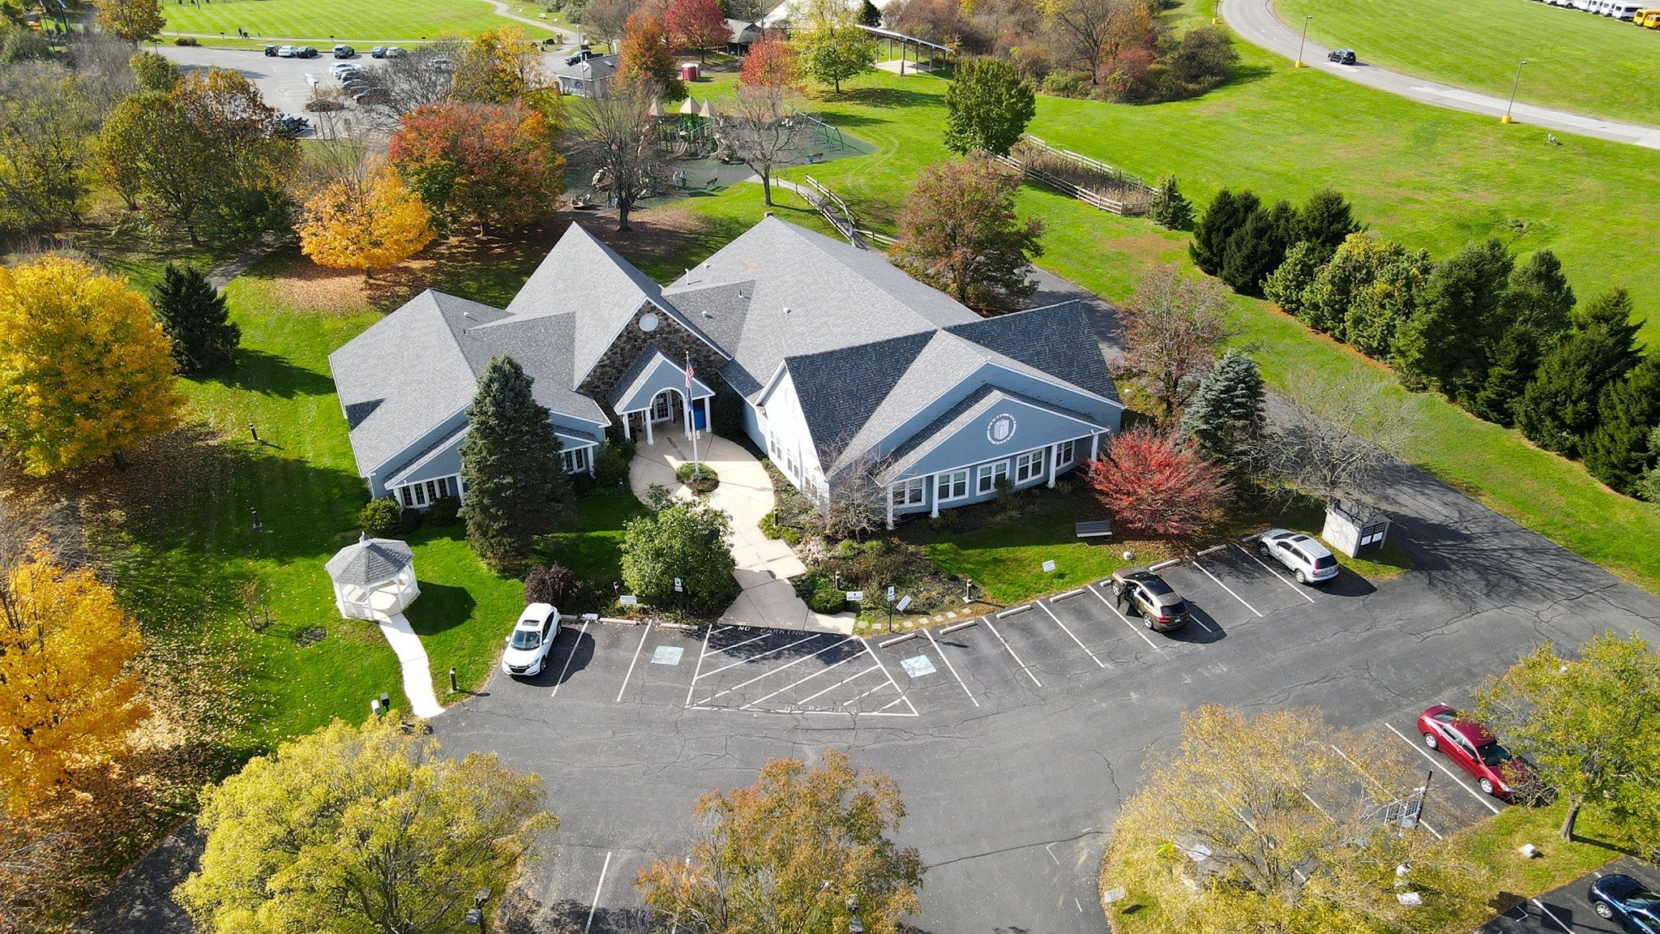

Library Tax Referendum
Rachel Kohl Community Library | Resolution No. 2026-33
Bethel Township Board of Supervisors | August 11, 2026

Slide 2




Should the Board Send a Proposed Library Tax Increase to Voters?
Resolution 2026-33 would put one question on the November ballot: raise the library tax from .027 mills to .037 mills, $1.00 more per $100,000 of assessed value.
Why an increase is being considered:
Use is high and rising
Funding falls short
Repairs are being deferred
Circulation and programs are up. Digital content has not replaced physical use.
Bethel funds the library below state guidance ($5/resident/year).
Roof, HVAC, and restroom work is postponed while monthly repair costs continue.

Slide 3
The Library Is an Independent Nonprofit That Five Municipalities Fund Together
1979: Opened in a vacant closet at Concord Elementary School.
1981: Joined the Delaware County Library System; service area expanded to include Chadds Ford and Thornbury.
1989: Private donations plus a $300,000 federal grant funded the Smithbridge Road building.
How it is governed
Independent 501(c)(3), organized in 1979. The Township does not own or operate it.
Serves Bethel, Chadds Ford, Chester Heights, Concord, and Thornbury.
Trustee seats follow population: Concord 4, Bethel 2, and 1 each for the others.
Bought its building from Concord Township in 2010; $160,637 still owed at the end of 2023.
What Bethel provides
A dedicated Library Fund, budgeted at $36,000 for 2026.
That was 7% of the library’s 2025 revenue. Concord provided 36%.
Sources: RKCL audited financial statements 2023, Notes 1 and 6; DCL 2025 Impact Report p. 34; Bethel Township 2026 Adopted Budget; RKCL Trustees, June 2026.

Slide 4




Use Is High Today and Higher Than It Was in 2017
234,822
40,000
486
10,369
Items circulated in 2025, about 19,600 a month
Library visits in 2025
Programs held in 2025, about 40 a month
Program attendance in 2025
Since 2017, Bethel circulation is up 25% and programming is up 58%.
The population of the five municipalities grew 37% over 20 years.
Sources: DCL 2025 Impact Report p. 34 (2025 figures); RKCL Trustees, June 2026 (growth since 2017).

Slide 5
Bethel Residents Still Borrow More Physical Items Than E-Books
16,537
11,651
11.1
2.95M
Physical items borrowed by Bethel residents in 2020
E-books borrowed by the same residents in the same year
Items circulated per resident served in 2025, ahead of Radnor and Haverford
Items circulated countywide in 2025, about 8,090 a day
Beyond borrowing and circulation, countywide in 2025, Delaware County Libraries recorded:
    1,509,251 visits
    120,590 public computer sessions
    105,416 reference questions.
    In-person use remains high.
Sources: DCL 2025 Impact Report pp. 7, 14, 34, 36; DCL Municipal Per Capita Funding Profile 2020.
Per-resident figures calculated from reported circulation and population served.

Slide 6




Despite Heavy Use, Library Funding Falls Short
AC System
Roof
Bathrooms
Costing $600–$1,800/mo in repairs on a system with obsolete parts: full replacement deferred.
Patch repairs running $750–$2,000/mo, in place of a full replacement.
Public restrooms are non-functioning or need costly pipe repair and replacement.
The library has done what it can. It refinanced its mortgage and depends heavily on grants and fundraising. None of that enables repairing the roof, HVAC, or bathrooms.
Sources: RKCL Trustees, June 2026 (repair costs); RKCL audited financial statements 2023, p. 7; DCL 2025 Impact Report p. 34.

Slide 7

Bethel Funds the Library at $3.68 per Resident, Below the State’s Guidance of $5.00 per Resident
Pennsylvania ties additional state aid (Quality Libraries Aid) to a $5 per resident threshold measured across the municipalities the library serves.
Bethel’s library tax yields about $3.68 per resident, leaving money on the table.
More Use than Support
Bethel provides about 12.5% of the five municipalities’ support, and accounts for about 24% of their combined circulation.
Chadds
Ford
Bethel
Chester
Heights
Thornbury
Concord
PA Guidance
Sources: Resolution 2026-33 ($3.68); RKCL Trustees, June 2026 (2024 figures); DCL 2025 Impact Report p. 34; DCL Municipal Per Capita Funding Profile 2020.

Slide 8
The Ask: $1.00 More per $100,000 of Assessed Value, About $13,000 a Year
 | Current | Proposed | Increase
Millage rate | 0.027 | 0.037 | 0.010
Total revenue | ~$36,000 | ~$49,000 | ~$13,000
Average $ / resident / year | $3.68 | $5.00+ | $1.32
Cost per $100,000 of assessed value | $2.70 | $3.70 | +$1.00
Property assessed at $250,000 | $6.75 | $9.25 | +$2.50
Property assessed at $400,000 | $10.80 | $14.80 | +$4.00
Sources: Resolution 2026-33; Bethel Township 2026 Adopted Budget, Library Fund. Revenue uses the 2026 budgeted library tax.

Slide 9

Questions Before Tonight’s Vote
Didn’t voters already approve a library tax in 2006?
What if voters say no?
Does this guarantee the additional state funding?
Why put this to voters?
Residents created this tax themselves by vote in 2006. The Library asked for a referendum so the residents could again decide on the library tax.
The library tax stays at 0.027 mills. The Board could still raise it later, though it would be doing so after voters said no.
No. Every municipality the library serves has to reach $5.00 per resident before the extra state aid is available. If Bethel residents vote “yes”, one more municipality would still have to act.
Yes, at .05 mills. The 2021 countywide reassessment legally required the Township to cut the rate to .027 mills so revenue stayed flat. This question asks voters to go above that level.
Sources: Resolution 2026-33; RKCL Trustees, June 2026.

Slide 10
Questions Residents Will Ask
Isn’t library use declining now that everything is digital?
Why isn’t fundraising enough?
Does this fully fund the library?
Why should residents who don’t use the library pay?
Local fundraising already supplies 33% of the library’s revenue, its second-largest source. It covers operations. It has not been able to fund roof or HVAC replacement.
No. It addresses deferred repairs and brings Bethel to the state’s guidance level. The library will still rely on fundraising, grants, and county and state support.
Most township services work that way: residents pay for fire, EMS, and parks whether or not they use them in a given year. Disagreement about that is another reason to put it on the ballot.
No. Circulation, visits, and programs are all above their 2017 levels. Bethel residents still borrowed more physical items than e-books in 2025.
Sources: DCL 2025 Impact Report pp. 8, 14, 26, 34, 36, 44; DCL Municipal Per Capita Funding Profile 2020; Bethel Township 2026 Adopted Budget.

Slide 11


What Happens Next?
1
2
3
4
Library Trustees Presentation
Solicitor Proposes Language, Board Votes
Filing with the County
General Election
Library Board of Trustees requests Bethel Township Board consider a referendum
Township Solicitor provides proposed ballot question wording. Bethel Township Board votes.
The Resolution directs the Solicitor to file a certified copy with the Delaware County Bureau of Elections.
Bethel Township voters decide the referendum.
June 9, 2026
August 11, 2026
Deadline to be confirmed by the Solicitor
Nov 3, 2026
Source: Resolution 2026-33, Section 2. The statutory filing deadline is not stated in the Resolution and needs the Solicitor’s confirmation.

Slide 12
Proposed Language for the Vote
REFERENDUM QUESTION
“Do you favor increasing the annual tax on the assessed value of all taxable real property situated in Bethel Township from .027 mills to .037 mills to aid in maintaining the Rachel Kohl Community Library?”
EXPLANATORY STATEMENT
In 2006 voters in Bethel Township instituted an annual tax on the assessed value of all taxable real property situated in Bethel Township at the rate of .05 mills, which equates to $5 per $100,000 of assessed value, to support Rachel Kohl Community Library (the “Library Tax”). In 2021, when Delaware County reassessed the value of all taxable real estate, state law required the Township to reduce the Library Tax millage to .027 mills. At the current rate of .027 mills, the Library Tax costs $2.70 per $100,000 of assessed value annually. The purpose of the foregoing question is to determine whether the Township should increase the Library Tax to .037 mills. The proposed rate of .037 mills would cost $3.70 per $100,000 of assessed value, an increase of $1.00 per $100,000 per year. This would provide the Rachel Kohl Community Library (the “Library”) with a total tax revenue from Bethel Township of just over $5.00 per resident in Bethel Township, which is the level required throughout Library’s service area to qualify for Quality Libraries Aid, a form of additional funding from the Commonwealth.
Source: Resolution 2026-33, Section 1, which contains both the question and the explanatory statement.

Slide 13
Sources
Township
Resolution No. 2026-33, Township Solicitor’s draft
Bethel Township 2026 Adopted Budgets, adopted December 9, 2025. https://www.betheltwp.com/media/ArchiveCenter/Budget%20Meeting/2026/2026%20Approved%20Budget.pdf
Library
Rachel Kohl Community Library Board of Trustees, presentation to the Bethel Township Board of Supervisors, June 2026. https://www.youtube.com/watch?v=IHJDhvCd-Ng
Rachel Kohl Community Library, audited financial statements, year ended December 31, 2023. https://www.kohllibrary.org/wp-content/uploads/2025/02/RKCL-Audited-Financial-Statements-YE-12.31.2023-1.pdf
Delaware County Libraries
Delaware County Libraries, 2025 Impact Report. https://www.delcolibraries.org/impact-report
Delaware County Libraries System’s State Aided Libraries Municipal Per Capita Funding Profile, 2020. https://www.kohllibrary.org/wp-content/uploads/2022/01/Municipal-Funding-2020.xls

Slide 14
Appendix
Supporting detail

Slide 15
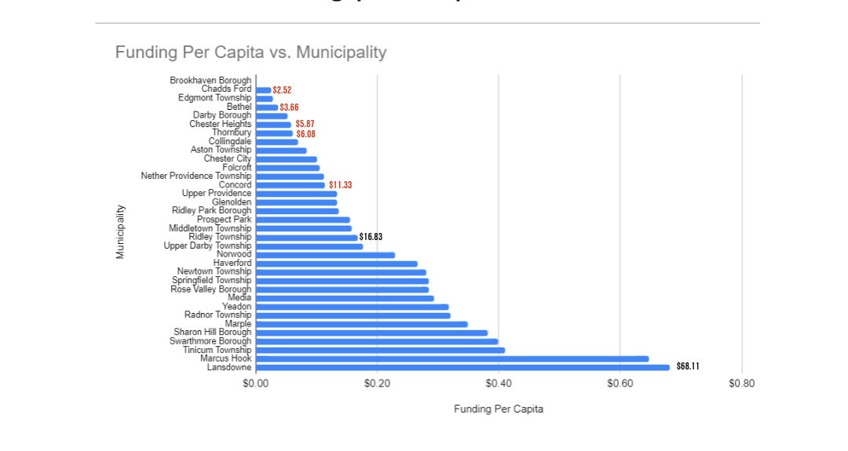
Per-Resident Funding Across the Five Municipalities
PA Recommendation
How Delaware County Municipalities Stack Up
Pennsylvania recommends municipalities fund local libraries at about $5.00 per resident.
Per resident, as reported by the Trustees (2024)
Chadds Ford | $2.52
Bethel | $3.68
Chester Heights | $5.87
Thornbury | $6.08
Concord | $11.33
Each figure is a municipality’s library funding divided by its population, as calculated by the Trustees for 2024.
The mechanisms differ. Bethel and Concord fund the library through a dedicated millage set by referendum. Chadds Ford adds an appropriation to its referendum millage. Chester Heights and Thornbury fund by annual appropriation.
Source: RKCL Trustees, June 2026. Bethel shown as $3.68, the figure used in Resolution 2026-33; the Trustees reported $3.66.

Slide 16
Funding Varies by Municipality
Municipal Appropriations, 2016 vs. 2025 ($)
Bethel & Concord
Fund the Library through a dedicated annual millage set by referendum.
Municipality | 2016 | 2025 | Change
Bethel | 35,000 | 38,056 | +8.7%
Chadds Ford | 8,000 | 10,000 | +25.0%
Chester Heights | 10,000 | 17,000 | +70.0%
Concord | 178,004 | 192,801 | +8.3%
Thornbury | 30,000 | 42,000 | +40.0%
Chadds Ford
Has a referendum in place; Supervisors have rounded the contribution up as an extra appropriation.
Chester Heights & Thornbury
Provide direct cash appropriations set through their annual budgets.
Costs have risen 38.8% over the past 10 years.
Source: RKCL Trustees, June 2026.

Slide 17
Financial Summary, 2023–2025
 | 2023 | 2024 | 2025
Township Support | 306,006 | 317,085 | 299,857
County / State Support | 53,111 | 60,780 | 62,908
Fundraising Revenue | 116,904 | 93,453 | 119,617
One-Time Grant Revenue | — | 174,203 | —
Library Operations Revenue | 28,015 | 22,825 | 40,211
Other Revenue | 5,199 | — | —
Interest Income | 13,222 | 14,089 | 16,027
Total Revenue | 522,457 | 682,435 | 538,620
Total Expenses | 473,767 | 502,576 | 534,841
Net Income / (Loss) | 48,690 | 179,859 | 3,779
Net Income / (Loss) if Fundraising/Grant Not Received | (68,214) | (87,797) | (115,838)
Source: RKCL Trustees, June 2026.

Slide 18
Program Growth, 2017–2025
 | 2017 | 2018 | 2019 | 2020 | 2021 | 2022 | 2023 | 2024 | 2025 | % Change
Adult | 99 | 149 | 149 | 0 | 69 | 65 | 79 | 170 | 184 | +85.9%
Youth | 221 | 344 | 344 | 0 | 91 | 158 | 200 | 274 | 317 | +43.4%
Total | 320 | 493 | 493 | 0 | 160 | 223 | 279 | 444 | 501 | +56.6%
Source: RKCL Trustees, June 2026.

Slide 19
Facility Improvements & Challenges
Improvements
Challenges
Expanded Children's Library; reconfigured space for tutoring and quiet study
Replaced building siding (with township support)
Kept the aging AC system running through interim repairs
Improved fiscal management and reduced near-term financial risk since past insolvency concerns
Bathrooms non-functioning or need costly pipe repair/replacement
Electricity costs have increased
Main library area needs room separation per patron feedback
Roof repairs run $750–$2,000/month*
AC system costs $600–$1,800/month in repairs and needs full replacement (obsolete parts)
Source: RKCL Trustees, June 2026. The children’s library expansion was funded by grant and private donation (RKCL audited financial statements 2023).

Slide 20
Program Growth, 2017–2025
 | 2017 | 2018 | 2019 | 2020 | 2021 | 2022 | 2023 | 2024 | 2025 | % Change
Adult | 99 | 149 | 149 | 0 | 69 | 65 | 79 | 170 | 184 | +85.9%
Youth | 221 | 344 | 344 | 0 | 91 | 158 | 200 | 274 | 317 | +43.4%
Total | 320 | 493 | 493 | 0 | 160 | 223 | 279 | 444 | 501 | +56.6%
Source: RKCL Trustees, June 2026.

Slide 21
Bethel Residents Still Borrow More Physical Items Than E-Books
16,537
11,651
11.1
2.95M
Physical items borrowed by Bethel residents in 2020
E-books borrowed by the same residents in the same year
Items circulated per resident served in 2025, ahead of Radnor and Haverford
Items circulated countywide in 2025, about 8,090 a day
Beyond borrowing and circulation, countywide in 2025, Delaware County Libraries recorded:
    1,509,251 visits
    120,590 public computer sessions
    105,416 reference questions.
    In-person use remains high.
Sources: DCL 2025 Impact Report pp. 7, 14, 34, 36; DCL Municipal Per Capita Funding Profile 2020.
Per-resident figures calculated from reported circulation and population served.

Slide 22
Per-Resident Funding Across the Five Municipalities
PA Recommendation
How Delaware County Municipalities Stack Up
Pennsylvania recommends municipalities fund local libraries at about $5.00 per resident.
Per resident, as reported by the Trustees (2024)
Chadds Ford | $2.52
Bethel | $3.68
Chester Heights | $5.87
Thornbury | $6.08
Concord | $11.33
Each figure is a municipality’s library funding divided by its population, as calculated by the Trustees for 2024.
The mechanisms differ. Bethel and Concord fund the library through a dedicated millage set by referendum. Chadds Ford adds an appropriation to its referendum millage. Chester Heights and Thornbury fund by annual appropriation.
Source: RKCL Trustees, June 2026. Bethel shown as $3.68, the figure used in Resolution 2026-33; the Trustees reported $3.66.

Slide 23
Funding Varies by Municipality
Municipal Appropriations, 2016 vs. 2025 ($)
Bethel & Concord
Fund the Library through a dedicated annual millage set by referendum.
Municipality | 2016 | 2025 | Change
Bethel | 35,000 | 38,056 | +8.7%
Chadds Ford | 8,000 | 10,000 | +25.0%
Chester Heights | 10,000 | 17,000 | +70.0%
Concord | 178,004 | 192,801 | +8.3%
Thornbury | 30,000 | 42,000 | +40.0%
Chadds Ford
Has a referendum in place; Supervisors have rounded the contribution up as an extra appropriation.
Chester Heights & Thornbury
Provide direct cash appropriations set through their annual budgets.
Costs have risen 38.8% over the past 10 years.
Source: RKCL Trustees, June 2026.

Slide 24
Sources
Township
Resolution No. 2026-33, Township Solicitor’s draft
Bethel Township 2026 Adopted Budgets, adopted December 9, 2025. https://www.betheltwp.com/media/ArchiveCenter/Budget%20Meeting/2026/2026%20Approved%20Budget.pdf
Library
Rachel Kohl Community Library Board of Trustees, presentation to the Bethel Township Board of Supervisors, June 2026. https://www.youtube.com/watch?v=IHJDhvCd-Ng
Rachel Kohl Community Library, audited financial statements, year ended December 31, 2023. https://www.kohllibrary.org/wp-content/uploads/2025/02/RKCL-Audited-Financial-Statements-YE-12.31.2023-1.pdf
Delaware County Libraries
Delaware County Libraries, 2025 Impact Report. https://www.delcolibraries.org/impact-report
Delaware County Libraries System’s State Aided Libraries Municipal Per Capita Funding Profile, 2020. https://www.kohllibrary.org/wp-content/uploads/2022/01/Municipal-Funding-2020.xls

Slide 25
The Ask: $1.00 More per $100,000 of Assessed Value, About $13,000 a Year
 | Current | Proposed | Increase
Millage rate | 0.027 | 0.037 | 0.010
Total revenue | ~$36,000 | ~$49,000 | ~$13,000
Average $ / resident / year | $3.68 | $5.00+ | $1.32
Cost per $100,000 of assessed value | $2.70 | $3.70 | +$1.00
Property assessed at $250,000 | $6.75 | $9.25 | +$2.50
Property assessed at $400,000 | $10.80 | $14.80 | +$4.00
Sources: Resolution 2026-33; Bethel Township 2026 Adopted Budget, Library Fund. Revenue uses the 2026 budgeted library tax.

Slide 26
Use Is High Today and Higher Than It Was in 2017
234,822
40,000
486
10,369
Items circulated in 2025, about 19,600 a month
Library visits in 2025
Programs held in 2025, about 40 a month
Program attendance in 2025
Since 2017, Bethel circulation is up 25% and programming is up 58%.
The population of the five municipalities grew 37% over 20 years.
Sources: DCL 2025 Impact Report p. 34 (2025 figures); RKCL Trustees, June 2026 (growth since 2017).

Slide 27
Bethel Residents Still Borrow More Physical Items Than E-Books
16,537
11,651
11.1
2.95M
Physical items borrowed by Bethel residents in 2020
E-books borrowed by the same residents in the same year
Items circulated per resident served in 2025, ahead of Radnor and Haverford
Items circulated countywide in 2025, about 8,090 a day
Beyond borrowing and circulation, countywide in 2025, Delaware County Libraries recorded:
    1,509,251 visits
    120,590 public computer sessions
    105,416 reference questions.
    In-person use remains high.
Sources: DCL 2025 Impact Report pp. 7, 14, 34, 36; DCL Municipal Per Capita Funding Profile 2020.
Per-resident figures calculated from reported circulation and population served.

Slide 28
Despite Heavy Use, Library Funding Falls Short
AC System
Roof
Bathrooms
Costing $600–$1,800/mo in repairs on a system with obsolete parts: full replacement deferred.
Patch repairs running $750–$2,000/mo, in place of a full replacement.
Public restrooms are non-functioning or need costly pipe repair and replacement.
The library has done what it can. It refinanced its mortgage and depends heavily on grants and fundraising. None of that enables repairing the roof, HVAC, or bathrooms.
Sources: RKCL Trustees, June 2026 (repair costs); RKCL audited financial statements 2023, p. 7; DCL 2025 Impact Report p. 34.

Slide 29
Should the Board Send a Proposed Library Tax Increase to Voters?
Resolution 2026-33 would put one question on the November ballot: raise the library tax from .027 mills to .037 mills, $1.00 more per $100,000 of assessed value.
Why an increase is being considered:
Use is high and rising
Funding falls short
Repairs are being deferred
Circulation and programs are up. Digital content has not replaced physical use.
Bethel funds the library below state guidance ($5/resident/year).
Roof, HVAC, and restroom work is postponed while monthly repair costs continue.

Slide 30
The Library Is an Independent Nonprofit That Five Municipalities Fund Together
1979: Opened in a vacant closet at Concord Elementary School.
1981: Joined the Delaware County Library System; service area expanded to include Chadds Ford and Thornbury.
1989: Private donations plus a $300,000 federal grant funded the Smithbridge Road building.
How it is governed
Independent 501(c)(3), organized in 1979. The Township does not own or operate it.
Serves Bethel, Chadds Ford, Chester Heights, Concord, and Thornbury.
Trustee seats follow population: Concord 4, Bethel 2, and 1 each for the others.
Bought its building from Concord Township in 2010; $160,637 still owed at the end of 2023.
What Bethel provides
A dedicated Library Fund, budgeted at $36,000 for 2026.
That was 7% of the library’s 2025 revenue. Concord provided 36%.
Sources: RKCL audited financial statements 2023, Notes 1 and 6; DCL 2025 Impact Report p. 34; Bethel Township 2026 Adopted Budget; RKCL Trustees, June 2026.

